Slide 3
You are muted to prevent background noise. Click on the mic or phone icon here when you want to say something.
You can change your name here - add your pronoun
Open the chat by clicking here now!

Slide 4
Call etiquette
Mute microphone when not speaking
Type * in chat window to speak
Type ++ in chat to agree with a speaker
Feel free to use body signals to show you’re engaging: thumbs up, smiles, nods…
Use L for language in chat or with hands if you don’t understand something/need me to slow down.
Use chat to ask questions but not for side conversations
If you’re having any tech issues, just put in the chat. Folks joining on the phone, share your questions out loud.
If you get disconnected, or are having any tech troubles and can’t access the Zoom call- give Molly a ring 07765949385

Slide 5
Call etiquette
The project 2020/21
Adapted the project cycle based on feedback from you- a year is not enough time to develop and implement the work in your SMHAs effectively.
Reporting has been altered to fit within this new structure.
The work involved in putting a SMHA together, and our Steps to Success, haven’t changed dramatically- there’s just more time for the work to be embedded, reviewed, and evaluated.

Slide 6
The project diary…
Can be updated as you work through the year
Similar to this year’s End of Year report, asking you to reflect and make a note of progress at each working group meeting
Working areas and action points can be directly copied and pasted in
Useful in the event of staff/student officer changes
Can be as detailed/brief as you need it to be
The mid-point review and end of year report are included in the project diary, so there’s no extra forms you need to fill in- just send us your project diary

Slide 7
If you think of any questions throughout the day please make a note and ask them at our Q&A session.
Or, add them to our Padlet board here- https://padlet.com/mollygreasley/k5jrxfllg37v8pf5

Slide 9
Session plan
‘Digital exclusion’
How we as a project can help you increase engagement online
Some general tips
A discussion exercise where you can share your expertise and experiences
Finally, what you can do if you have further questions

Slide 10
Digital poverty and digital exclusion
Digital poverty: the state of not having adequate ICT facilities, resources or methods to be digital
Digital exclusion: lack of access to knowledge and communications technology.

Slide 11
According to Brendan Sanders: ‘digital exclusion is where a section of the population have continuing unequal access […] to ICT that are essential to fully participate in society.’

Slide 12
In an increasingly digital age, those who are not engaging effectively with the digital world are at risk of being left behind. […] This is leading to a digital divide […] giving rise to inequalities in access to opportunities, knowledge, services and goods.

Slide 13
What does this mean for Scotland?
Students living in rural areas where connection might not be as strong
Students who are living in socio-economically deprived locations
Paper-based methods (this might not be the most environmentally-friendly)

Slide 14
Social media calendar
Social media graphics pack
Social media monthly planner
How can Think Positive help?

Slide 15
Social media calendar
Specifically focused on mental health
Covers national days, weeks and events occurring in HE and FE
Helps to plan out social media through the year
Available on the website after today

Slide 17
Corresponds to dates set out in the social media calendar
Pictures to increase engagement
A pack of Facebook and Twitter images
Available in JPEG and EPS format on the website soon
Social media graphics pack

Slide 18
Social media monthly planner
Allows you to plan your social media more meticulously
Useful for planning campaigns, events
Managing tool to streamline your posts

Slide 19
Craft thoughtful posts

Slide 20
Share content that reflects your student demographic

Slide 21
Use a range of social media channels

Slide 22
Consider measuring analytics

Slide 23
Questions
and
thoughts

Slide 24
And finally….

Slide 26
Think Positive's Small Grant Scheme
The Participatory Grant 2020.

Slide 27
What is the Scheme?
We offer a maximum of £250 each to ten institutions signed up to our SMHA project, to fund a new idea/campaign/project which will help them meet one of their working areas.

Slide 28
Aim 1
To help challenge financial barriers which might prevent those taking part in the Student Mental Health Agreement Project from meeting their working areas.
Aims of the Small Grant Scheme
PITCH DECK V 1.0
Aim 2
To support student associations and their institutions to work together to provide a holistic approach to student mental health on their campuses.
PITCH DECK V 1.0
Aim 3
To allow fantastic new ideas which will support Scotland's student mental health to be trialled/piloted.

Slide 29
Application Process
How could we improve the application process to offer further support to applicants to develop their ideas?
Reflections from last year's pilot.
Projects' Timeframes
PITCH DECK V 1.0
Some projects felt that they needed a lot longer than we were able to offer last year to fully develop and be evaluate-able.
Participant-Led
It felt very much a project led by us; how can we make it more a project led by you?

Slide 30
Goal 1
To increase community participation in the decision making process to award Think Positive's Small Grants.
Why Participatory?
Goal 2
PITCH DECK V 1.0
To upskill all participants (including the Think Positive Team!) on funding processes and decision making.
Goal 3
To work towards our Student Mental Health Agreements being participant-led to share best practise.

Slide 31
How could this work?
Step 1: Refreshers' Event
Gather feedback and vote.
Step 2: Publicise new programme
Promote the Scheme in 121s and offer a workshop in September, "Inspiration, Ideation, Implementation", to build ideas.
Step 3: Applications Open
Applications open on October 2nd.
Next steps

Slide 32
How could this work?
Step 4: Applications Close
Applications close on November 2nd.
Step 5: Applications are shared with a supportive panel
The panel offers suggestions to strengthen proposals.
Step 6: Suggestions shared with applicants.
Applicants can choose to include any suggestions in their proposal.
Next steps

Slide 33
How could this work?
Step 7: All participants vote
Voting would open December 16th and close January 14th.
Step 8: Recipients announced.
Recipients announced on 18th January. All invoices to be sent to NUS.
Step 9: Buddy up!
Proposal to match applicants who don't recieve a grant this year with those who do, to share resources and processes.
Next steps

Slide 34
How could this work?
The Scheme would now match the new project year.
So, a project awarded in January 2021 would have until May 2022 to be introduced, piloted and evaluated.
Next steps

Slide 35
Decision 1
You decide!
Would you be happy for our Small Grant Scheme to move towards a Participatory Model?
This is your Small Grant Scheme; it needs to be designed with you to benefit you best.
PITCH DECK V 1.0

Slide 36
Decision 1.1
Who would we like to see on our "Supportive Panel"?
You decide!
Decision 1.2
How would we like to vote? Would we like a deliberative space within our own project teams, or the network of participants as a whole?
This is your Small Grant Scheme; it needs to be designed with you to benefit you best.
PITCH DECK V 1.0
Decision 1.3
Buddy up! How do we feel about the proposal to "buddy up" post voting, to share resources and processes?

Slide 37
Menti Meter
Please got to www.menti.com and type in 35 26 27.

Slide 38
Action 1
Your new Grant Scheme Pack will be shared with you via email on August 18th.
What happens next?
Action 2
PITCH DECK V 1.0
We will organise (dependent on your vote) the workshop/deliberative spaces necessary to support this process.
We'll put your feedback into action!

Slide 39
10 Recipients
1.9 Billion
Think Positive's Small Grant Scheme 2020
MUST BE SIGNED UP TO THE SMHA PROJECT.
£250 each
1.9 Billion
TOWARDS ONE WORKING AREA.
1 Proposal per Team
1.9 Billion
INSPIRATION. IDEATION. IMPLEMENTATION.

Slide 43
A safe space for people of colour to express themselves and for ALL to develop a critical understanding of racism and anti-racism.
Collective working to building an education system:
Free from racial injustice
Equitable
Critically engaged with identity, power and privilege.
Includes: blog, glossary, podcast, anti-racist reading lists, anti-racist listening lists, school resources and a white privilege test.

Slide 44
Racial Trauma Is Real
Racial trauma is used to describe the physical and psychological symptoms that People of Color often experience after exposure to particularly stressful experiences of racism (Carter, 2007). Similar to survivors of other types of trauma (e.g., sexual assault survivors), People of Color often experience fear and hypervigilance, headaches, insomnia, body aches, memory difficulty, self-blame, confusion, shame, and guilt after experiencing racism.
Jernigan et al. (2015), Institute for the Study and Promotion of Race and Culture

Slide 45
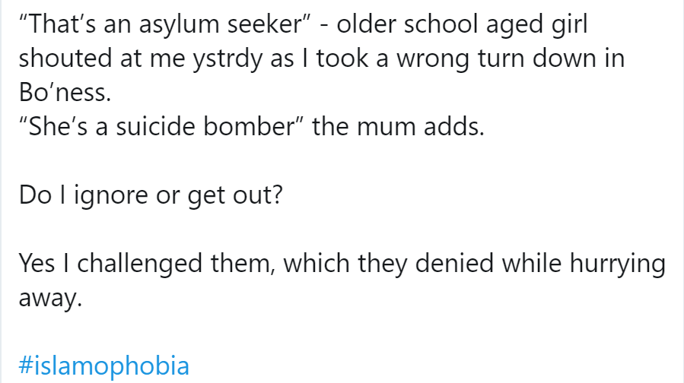
Unpacking The Word “Racism” 1. Interpersonal Racism
Prejudices and discriminatory behaviours where one group makes assumptions about the abilities, motives, and intents of other groups based on race.
This set of prejudices leads to cruel intentional or unintentional actions towards other groups.

Slide 48
Racial Trauma Is Real
Non-pathological (not a disorder; an injury)
Continuous (from cradle to grave)
Cumulative (microaggressions add up)
Collective (one event can affect many globally)
Subjective (everyone reacts differently)
Historical (remnants colonial violence still today)
Intergenerational (coping mechanism and epigenetic changes passed from generations)

Slide 49
“It was geography and we were studying third world development and the second the teacher said ‘Third world, including Africa’ everyone was just, like, slowly looking straight at me and I just felt kind of awkward ’cos I didn’t know what was going on. And then I realised what she had said. She was making a poster and had the devil and an angel and she had this white girl with fruit and a black family from Africa, so people think of it as hell.”
“one of my daughters [was] saying she wishes she was white ... that is hurting, disappointing for me because I don’t want her to be like that, I want her to be proud of her colour, proud of her culture. The school played a big role in that.”

Slide 50
Buffering Racial Trauma
ACKNOWLEDGE: Be aware and accept what you are feeling and thinking. Individuals respond to experiences of trauma differently.
DISCUSS: Open discussion can help to minimize the tendency to internalize negative racial experiences, which can lead to feelings of anger, sadness, or anxiety. Speaking to others who may have similar reactions can also be normalizing and validating.
SEEK SUPPORT: Seeking guidance and support from others will help to facilitate positive coping and management of racial trauma responses (mentors, counselling, etc.)
SELF CARE: In an effort to buffer the emotional and physical consequences of racial trauma, one should plan activities that promote a healthy mind, body, and spirit.
EMPOWERMENT THROUGH RESISTANCE: Be proactive by channeling the hurt, anger, and feelings of hopelessness and helplessness that you are feeling by participating in social-change activities in your community. In doing so, you can use your voice to speak out against racial injustices.
Notes:
In session we spoke about Similarity Attraction theory

Slide 51
Performative Allyship
Genuine Allyship
Shows off how much they know about anti-racism
Posts #BlackLivesMatter and condemns racism online or in public, only when people are there to see it.
Waits to a pat on the bat when discussing their white privilege
Feels entitled to hearing PoC’s opinions and lived experiences.
Doesn’t support a PoC facing a racially stressful/traumatic event, because it’s uncomfortable/awkward/too political.
Takes up space in PoC spaces.
Does not feel entitled to be educated or hear from PoC, but provide a compassionate, listening ear for any PoC who needs it.
Spends more time reflecting on their positionality and complicity, rather than publicly performing anti-racism for more likes.
Uses their power (financial and social) to support #BlackLivesMatter
Uses their power to address racial trauma (in mental health agreements)
Uses their power to support a PoC in a racially stressful/traumatic situation.
Respects the need for PoC-only spaces.

Slide 52
Group Discussion: Addressing Racial Trauma in the Student Mental Health Agreement

Slide 54
