Slide 1
To own your story
is to own your life
Christine Muir, Senior Communications Officer

Slide 2
Notes:
People and their experiences are at the heart of everything the
Scottish Recovery Network (SRN) do.
Everyone has mental health.
We believe that together we can make recovery real for everyone in every community.
Sharing stories and experiences has a huge part to play in this.
SRN works extensively with story across a range of projects. One of these is…

Slide 3
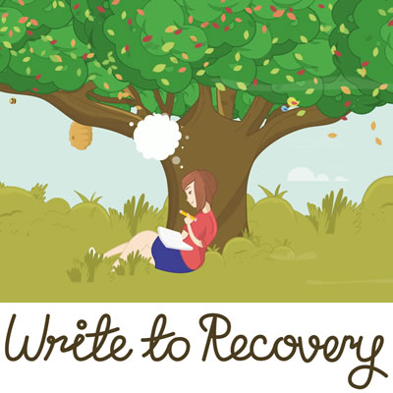
“I now see myself not as a victim,
but as someone who is resilient and strong”
Notes:
Write to Recovery is for anyone who has ever experienced some sort of distress, emotional difficulty or mental ill-health.
The aim of this project is to empower people to experience recovery by creating and taking control of their own story. By this, we mean thinking about and defining who they are for themselves.
Conversations about mental health are often focused on the negative effects of distress, emotional difficulties and mental ill-health. As a result of repeating these conversations over time, the problems and difficulties begin to define who the person is. For example, the person’s ‘story’ might become ‘I am someone with a drug problem’ or ‘I am someone who has had a traumatic experience’ or I am someone with OCD
BUT Every story has a flip side
Write to Recovery helps people see this
It recognises the fact that many people experiencing distress or with mental ill-health have had to face severe hardships – yet they’ve survived. So it’s clear they have exceptional resilience and strength. Write to Recovery helps people to harness resilience and recognise their strengths and share what has worked or not worked with others.

Slide 4
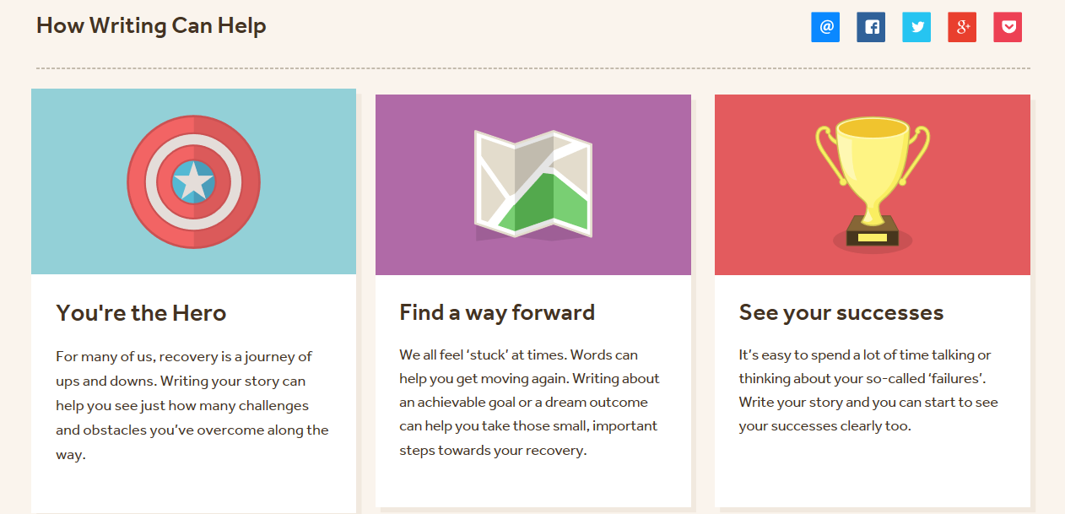
“It helped me find meaning in my experiences”
Notes:
You’re the hero of your story
Reframing your story puts you at the centre of your story – in other words you become the hero. You don’t have to be defined by the terms and phrases you hear as a result of mental health problems. You can take a much wider viewpoint.
When you write your story, you can begin to look back on your experiences over time and to reflect on your journey of recovery, with all its ups and downs.
Finding a way forward
Creating your story can also help you see some of the things that might help with your recovery – and some of the things that might hinder it.
For example, you might gain a new outlook on something, discover some positive qualities you never knew you had, or work out who or what you really value in life. Similarly you might see who or what is not helping your recovery and begin to think about ways you can change things and take more control of your life.
See your success - Helping you see the positives more clearly
Write to Recovery has developed prompts and inspiration designed to help you through the writing process but also to help you identify those strengths and successes that we so often struggle to acknowledge

Slide 5
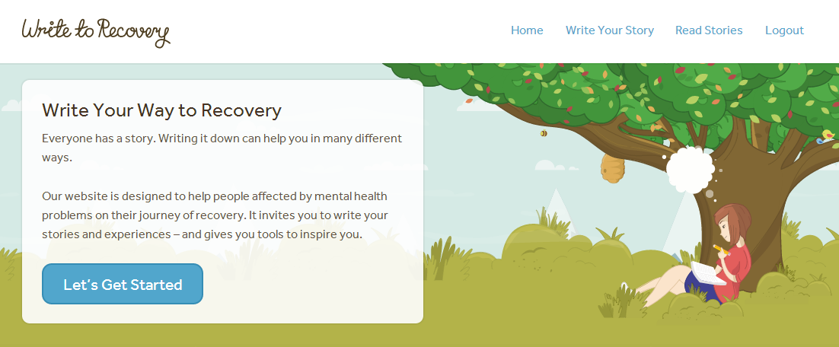
Launched 2014
819 published stories (83%)
986 stories written
www.writetorecovery.net

Slide 6
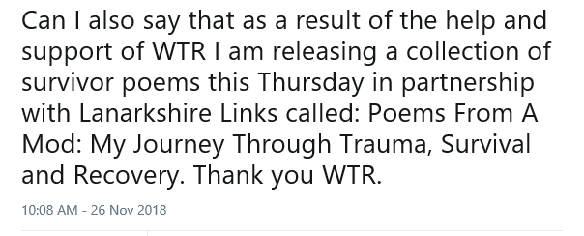
Write to Recovery group work
Initial 9 week programme
Strive to make groups sustainable beyond 9 weeks
Option for participants to become Facilitators
Facilitator training
Write to Recovery bounce
Notes:
Computer not essential – actually very rare that a group will go online as part of process but will maybe share after online
Strathclyde University case study

Slide 7
Write to Recovery group work
Pilot groups
3 year funding from the ALLIANCE Self Management
IMPACT fund
2 Group Facilitators
47 groups run since start 2017
17 are now self-sustaining
8 more groups in negotiation
1 week residency in Skye
Developing partnership with Recovery Colleges in N. Ireland
Worked with wide range of organisations
Staff support at organisations e.g. Scottish
Government
“It’s a good opportunity to share who you
are with others and connect to people”
Notes:
Rape Crisis Scotland, Say Woman, Healthy Valleys,
Addaction, Aberdeen, Glasgow, Glasgow Caledonian
Universities, Woman’s Aid, Penumbra, North Ayrshire
Wellbeing and Recovery College, Perth Prison,
Sunshine Recovery Cafe

Slide 8
Write to Recovery is:
Supporting people to write and share their thoughts
Helping people to recognise that they already possess a vast array of
skills strengths and abilities
Tackling social isolation and loneliness, disempowerment, low confidence
Tackling stigma and self-stigma
Tackling loss of hope
Encouraging natural peer support to develop in groups
Increasing people’s self-management skills
“I learn in the group that there is more than
one way to climb a mountain”

Slide 9
Write to Recovery is doing its job
The evidence is in the writing
High quality and creative
Demonstrates effectiveness of the prompts & guidance
Inspiring, emotional and powerful
Engages with distress and resilience
Evidence of taking responsibility for self
Giving people voice
Providing opportunities for peer support
Sharing self management skills
Building a community of authors
More to come…

Slide 10
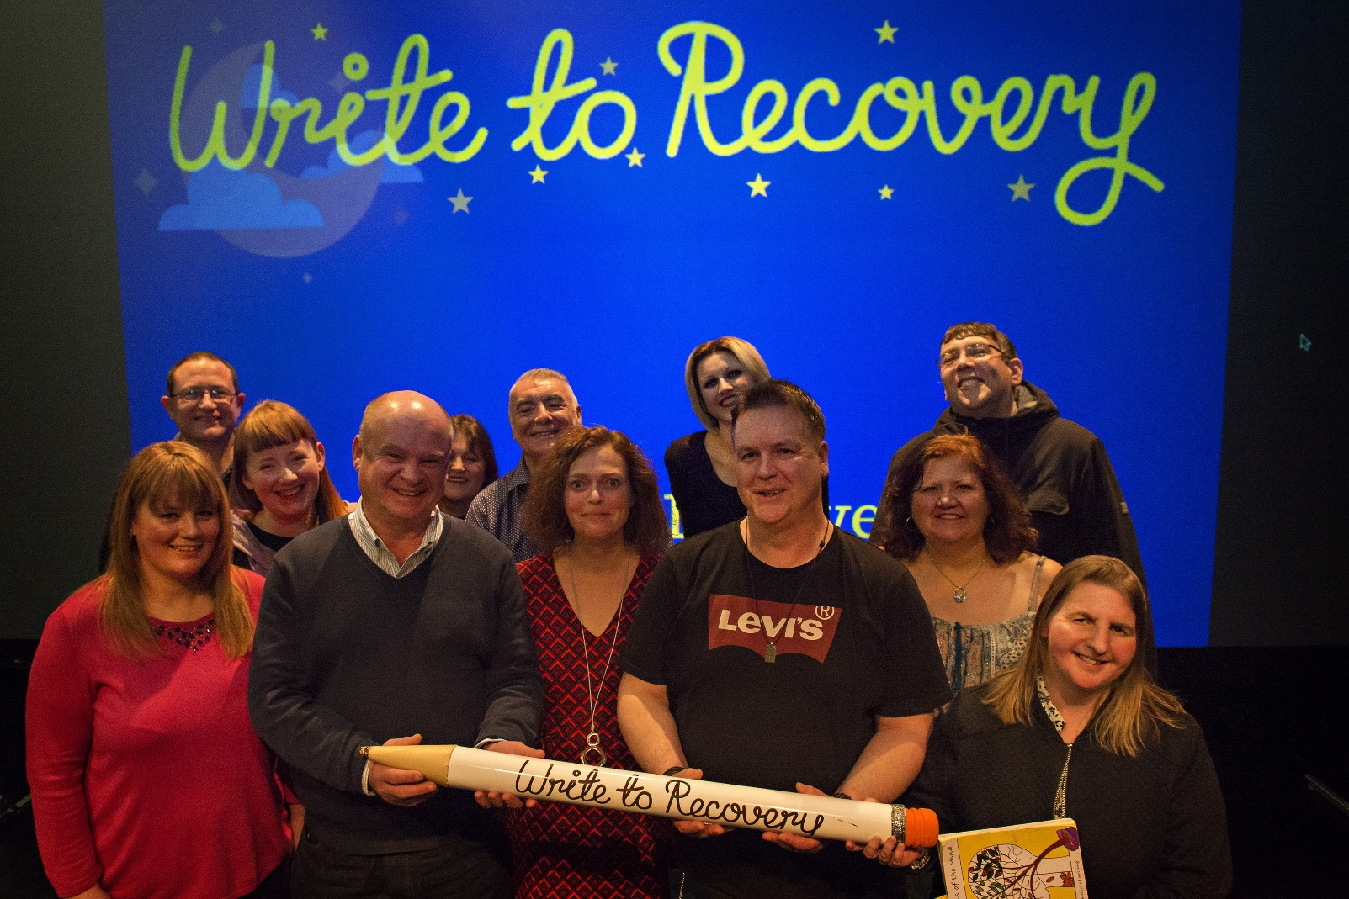
Write to Recovery: An Evening of Readings
“Great night and great mix of experiences shared.
Laughter, some tears and lots of things to reflect on.”
Notes:
Website users and group participants together

Slide 11
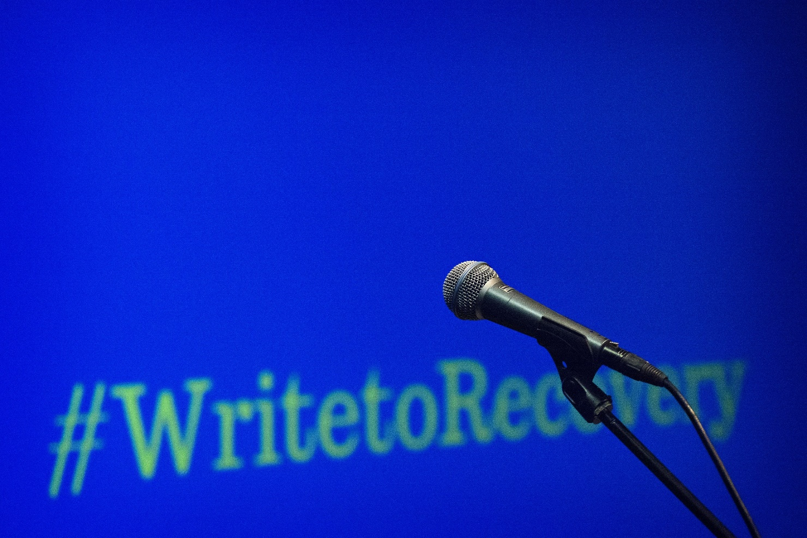
Podcasts

Slide 12
“It lets you see how your mood changes. It helps you see that IT DOES change. When you read back over what you previously wrote you can see how much you’ve changed. It’s like being able to reflect on your journey” - Participant

Slide 13
Find out more
christine.muir@scottishrecovery.net
emma.monaghan@scottishrecovery.net
www.scottishrecovery.net | @SRN_Tweet
www.writetorecovery.net | @Writeto_Recovery

