Slide 1
Social media hashtags: Staying connected, sharing ideas.
Reena Staves
Student Health Project Coordinator

Slide 2
2018/19 hashtags
Healthy Body Healthy Mind awards - #HBHM1819
Student Mental Health Agreement project - #SMHA1819

Slide 3
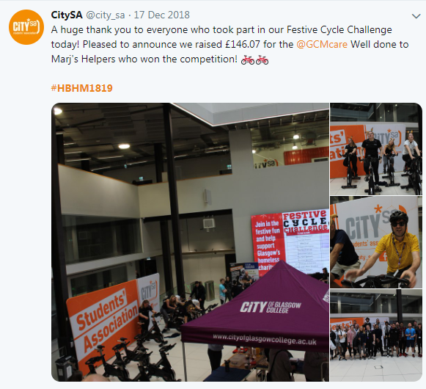
#HBHM1819

Slide 4
#HBHM1819

Slide 5
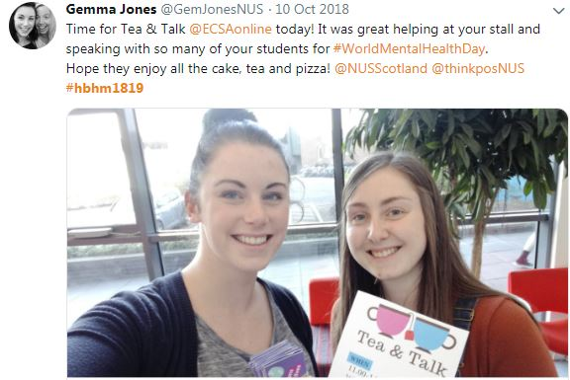
#HBHM1819

Slide 6
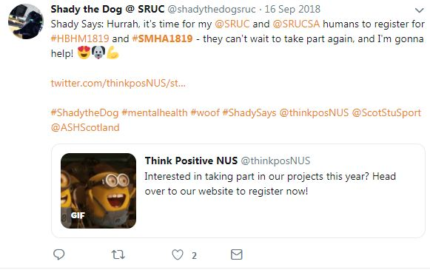
#SMHA1819

Slide 7
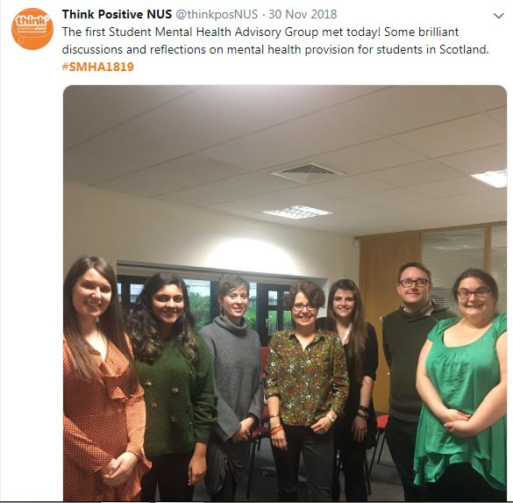
#SMHA1819

Slide 8
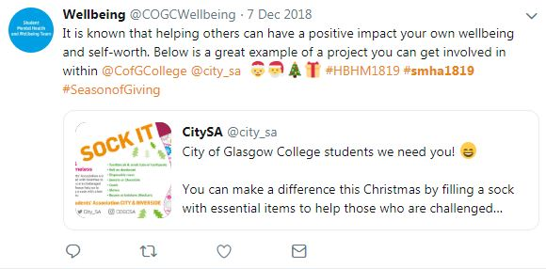
#SMHA1819

Slide 10
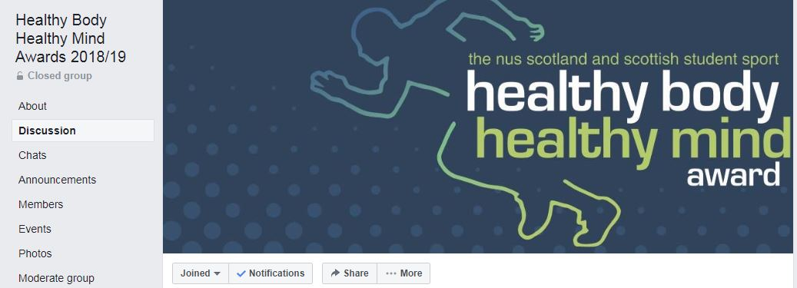
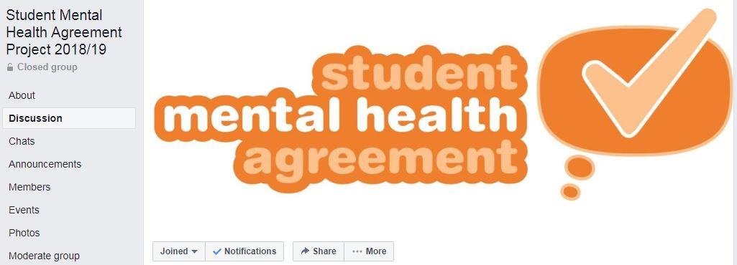
Join our groups!

Slide 11
Any questions?
Email me!
reena.staves@nus-scotland.org.uk

