Slide 1
GCU’s Student Mental Health Agreement From 2017-2019

Slide 2
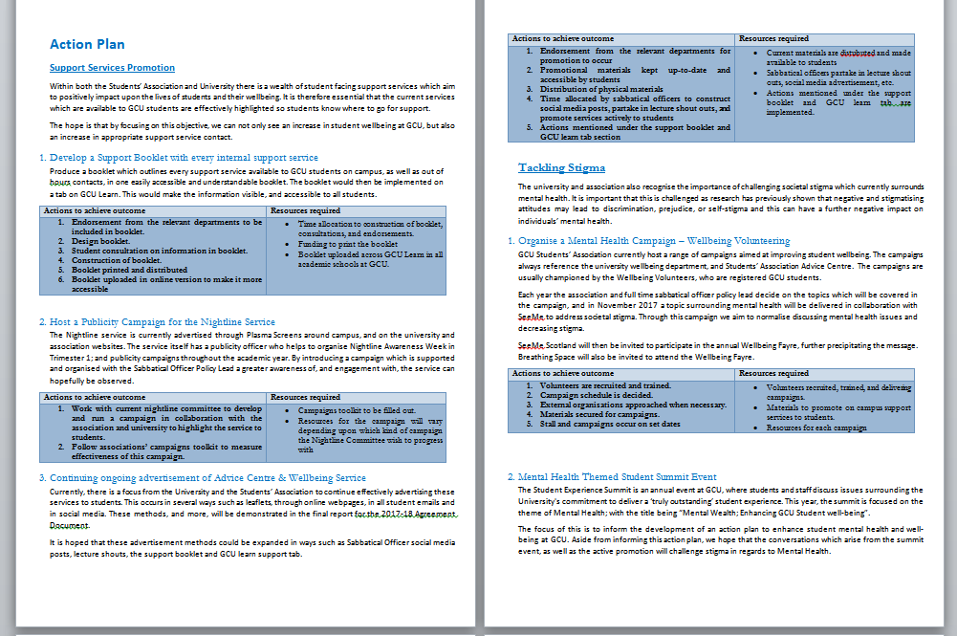
Background
Second year participating in project
Started Agreement with a look at the sector and background into student mental health
Linked to GCU and GCU Students’ Associations Strategic plans
Signed by myself and Deputy Vice Chancellor Academic
Holistic support provision

Slide 3
What we’ve done this year…
(So far!)

Slide 4
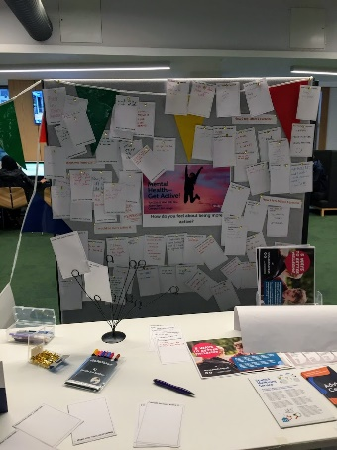
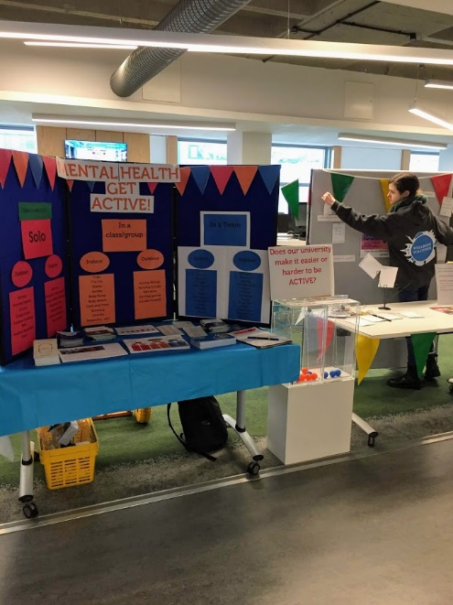
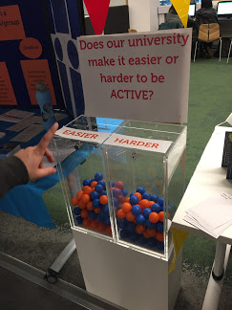
Nightline Publicity Campaign
Closed Free Yoga Groups
Mental Health / Physical Activity Campaign
Free Mindfulness Sessions

Slide 5
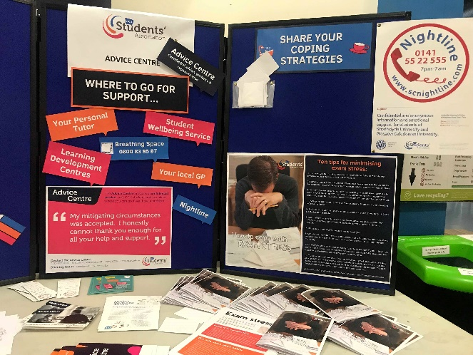
Advertising Advice Centre and Wellbeing Service
Opened Post-Graduate Space
Exam Stress Support
Introduced Social Meet – Up groups

Slide 6
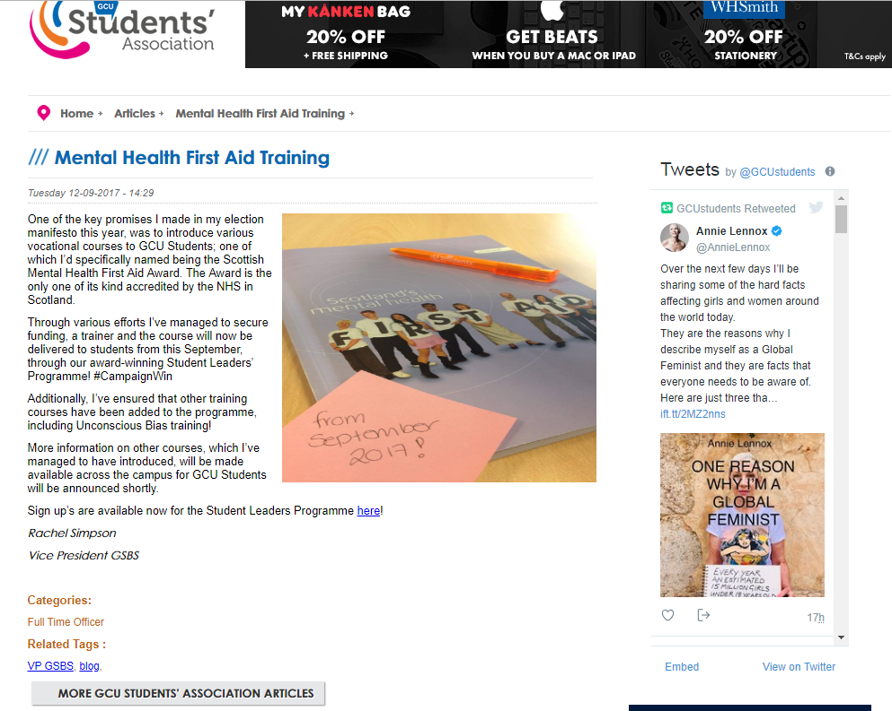
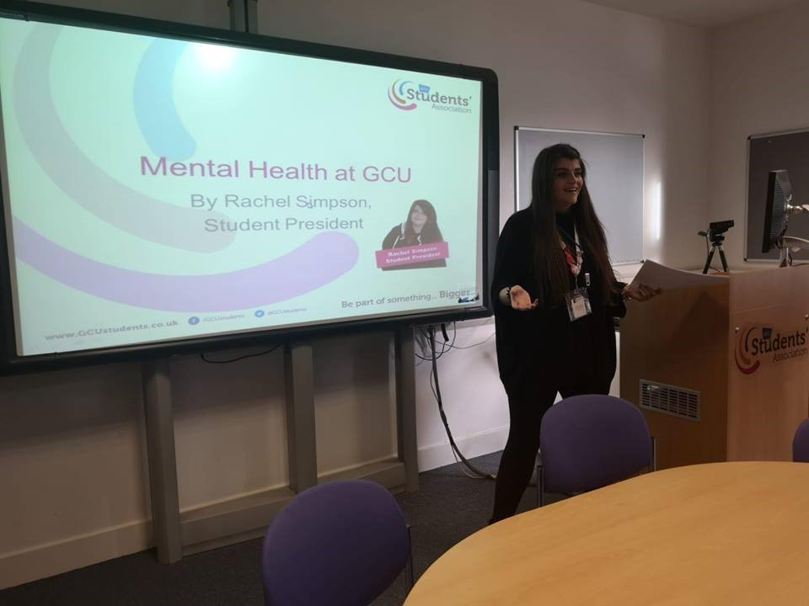
Lets’ Talk about GBV Workshops
Scottish Mental Health First Aid Award
Mental Health Workshop

Slide 7
Created several task groups to champion student and staff mental health
Student Mental Health Task Group
Mental Health at Work Task Force
HBHM Working Group
SMHA Working Group

Slide 8
Review Current Policies
1. Mitigating Circumstances Process Reviewed
2. Academic Advisor to Personal Tutor
INCLUDE Project (Mental health and our curriculum)

Slide 9
What we’re planning to do next trimester…

Slide 10
Campaign into Men’s Mental Wellbeing
Paws Against Stress Event
Student Mental Health Survey
Launch Event for Student Mental Health Agreement
Wellbeing Fayre
TriB Rep Workshop
INCLUDE

Slide 11
My top tips
(I’m in no way an expert)

Slide 12
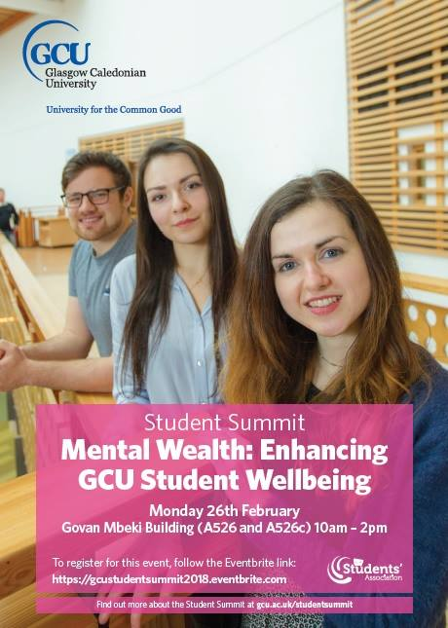
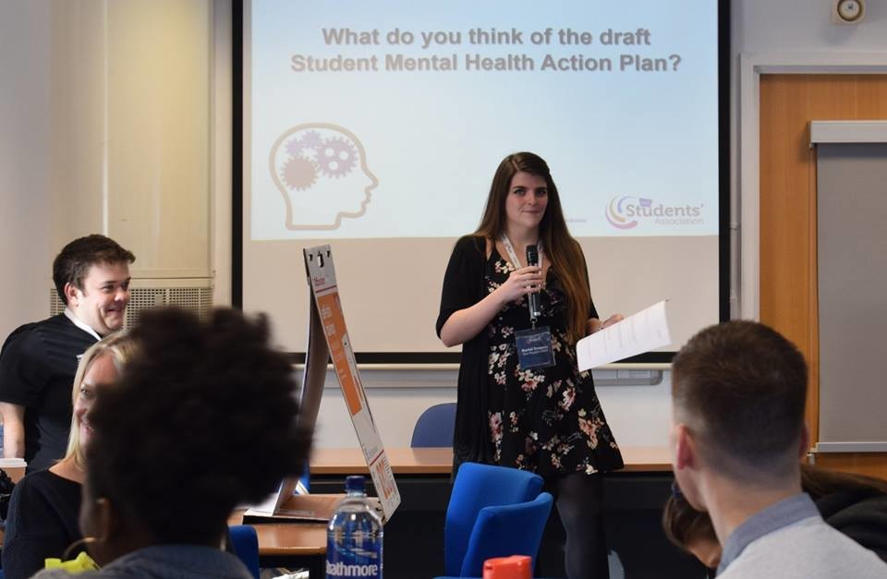
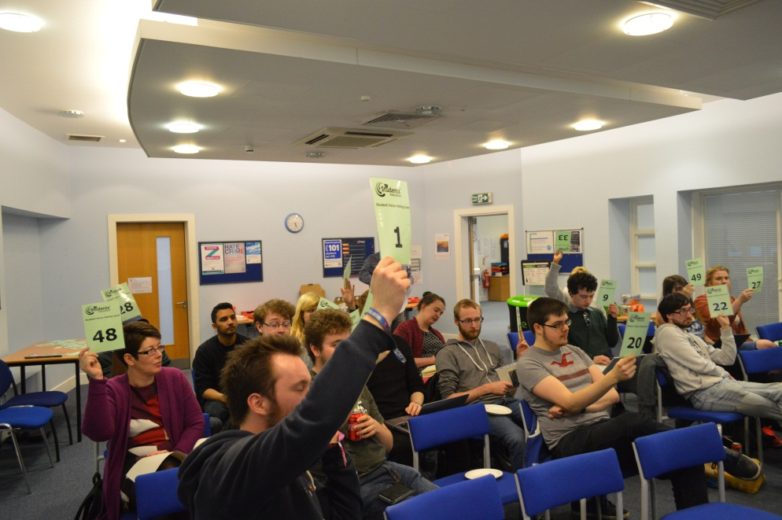
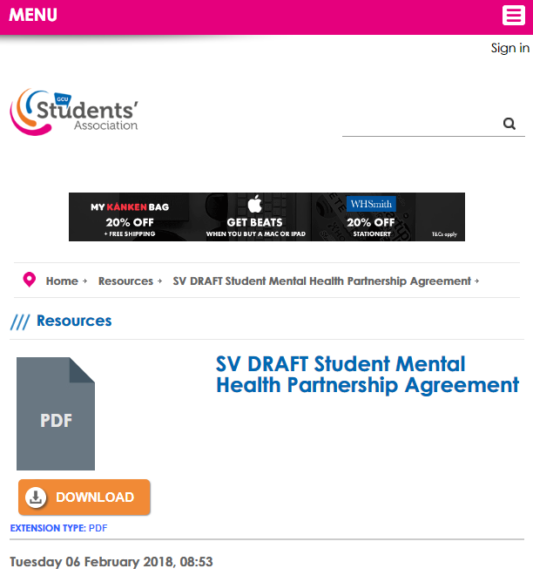
Publish your agreement

Slide 13
Publish your agreement
https://www.gcustudents.co.uk/advice-centre/student-mental-health-agreement

Slide 14
Make it sustainable!
Establish a Working Group for the Student Mental Health Agreement with your students’ association and institution
Create a working action plan
Save all your evidence as you go!

Slide 15
Challenges
Support Booklet – Launch of Services
External Speakers - Trimester A of 2018
Deciding what was a priority to continue and what you should develop

Slide 16
Overall
“We found it allowed us to work together to benchmark the services and support that we currently offer GCU Students’ and work towards ensuring we provide holistic support at Glasgow Caledonian University.”

Slide 17
Thanks for Listening!
Questions?

